Slide 1

IILM UNIVERSITY
Greater Noida, Uttar Pradesh
INTERNSHIP
IT Systems and Computer Operations Practical Training in the System Department at Central Coalfields Limited (CCL)
Student Name :
Shubhraj
Enrolment No. :
2410030269
Program :
B.Tech CSE
Organization :
Central Coalfields Limited

Slide 2
IILM UNIVERSITY
Candidate's Declaration
I, SHUBHRAJ, hereby declare that the internship report titled "AI Student Performance Prediction System" has been completed by me in fulfilment of the requirement for the award of the degree of Bachelor of Technology in Computer Science and Engineering. All references used have been duly acknowledged, and this report is my own original work, not submitted elsewhere for any other degree or diploma.
Student Name: SHUBHRAJ
Roll Number: 2410030269
Program: B.Tech CSE
Batch: 2024 – 2028

Slide 3
IILM UNIVERSITY
Acknowledgement
I would like to express my sincere gratitude to everyone who supported me throughout my internship at Central Coalfields Limited (CCL), System Department, Hazaribagh Area. Their guidance, constructive feedback and encouragement were invaluable to this work.
I am especially thankful to Mr. Suraj Kumar, SO (System) In-Charge, Hazaribagh Area, CCL, for his mentorship and for sharing his valuable insights throughout the internship.
I also extend my gratitude to the faculty of the School of Computer Science and Engineering, IILM University, Greater Noida, for their continuous support, and to my parents for their blessings.

Slide 4
IILM UNIVERSITY
Internship Overview
● Host Organization: Central Coalfields Limited (CCL), System Department, Hazaribagh Area, Charhi, Jharkhand
● Duration: Four weeks, from 3rd June 2026 to 3rd July 2026
● Mentor: Mr. Suraj Kumar, SO (System) In-Charge, Hazaribagh Area
● Academic Context: Undertaken as part of the B.Tech CSE curriculum at IILM University, Greater Noida
● Exposure Gained: System maintenance, software handling, data management and routine IT operations & troubleshooting
● Project Undertaken: "AI Student Performance Prediction System" – applying data-driven and machine learning techniques to predict student academic performance

Slide 5
IILM UNIVERSITY
Organization Profile
● Central Coalfields Limited (CCL) is a leading subsidiary of Coal India Limited (CIL).
● CIL is a Maharatna public sector undertaking under the Ministry of Coal, Government of India.
● CCL is headquartered in Ranchi, Jharkhand, and engaged in exploration, extraction and production of coal across Jharkhand, including the Hazaribagh Area.
● The System Department, Hazaribagh Area, manages computer systems, software infrastructure, data handling and IT-enabled operations.
● It ensures smooth day-to-day IT operations, technical troubleshooting and systems support across the area office.

Slide 6
IILM UNIVERSITY
Problem Statement & Objectives
Problem Statement
Educational institutions often rely on manual or ad-hoc methods to track student performance, making it difficult to identify at-risk individuals early or draw insights from historical data. A systematic, data-driven approach is needed to predict future performance and support timely intervention.
Project Objectives
● Study the factors that influence student academic performance
● Collect and preprocess relevant academic data for analysis
● Design and implement a machine learning model for performance prediction
● Evaluate the model using standard evaluation metrics
● Present predictions through a simple, interpretable dashboard

Slide 7
IILM UNIVERSITY
Scope & Technologies Used
Scope of the Project
The project is limited to building a prototype prediction system that takes academic and related attributes as input and outputs a predicted performance category. It covers the core data pipeline, model development and evaluation – full-scale deployment and real-time data integration are identified as future work.
Technologies and Tools Used
Technology / Tool | Purpose
Python | Core programming language for data processing and model development
Pandas / NumPy | Data handling, cleaning and numerical computation
Scikit-learn | Building and evaluating machine learning models
Matplotlib / Seaborn | Data visualization and result analysis
Jupyter Notebook | Interactive development and experimentation

Slide 8
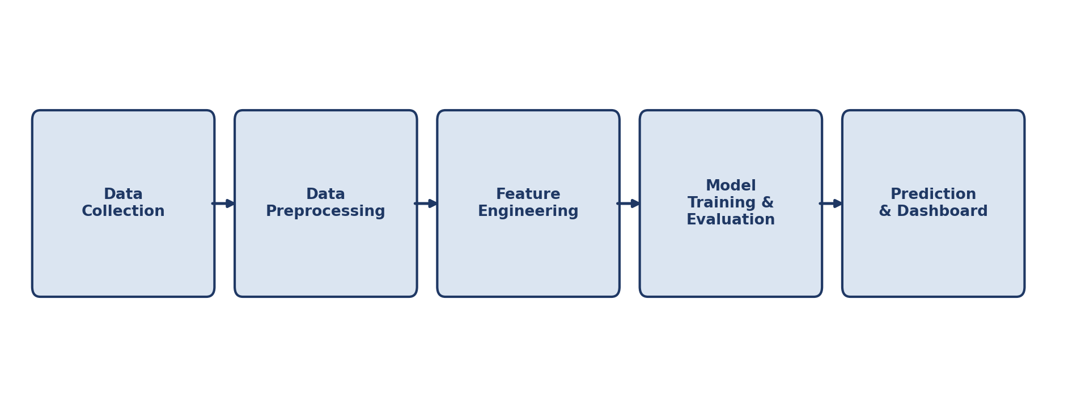
IILM UNIVERSITY
System Architecture
The system follows a linear data pipeline architecture consisting of five stages – from data collection through to final prediction and presentation of results.
Figure: System Architecture of the AI Student Performance Prediction System

Slide 9
IILM UNIVERSITY
Methodology
● Data Collection: Relevant student academic and demographic data were gathered / simulated for the study.
● Data Preprocessing: The collected data was cleaned to handle missing values, inconsistencies and outliers.
● Feature Engineering: Relevant features affecting student performance were identified and encoded for model consumption.
● Model Selection & Training: Suitable machine learning algorithms were selected and trained on the processed dataset.
● Evaluation: The trained model was evaluated using metrics such as accuracy, precision/recall, or RMSE.
● Deployment / Presentation: The final predictions were presented through a simple, interpretable output for end users.

Slide 10
IILM UNIVERSITY
Expected Outcomes & References
Expected Outcomes
References
● A working prototype capable of predicting student performance from academic data
● Early identification of students who may need additional academic support
● Improved understanding of the key factors influencing student performance
● A foundation for a future, fully deployable, institution-wide prediction system
● Central Coalfields Limited – Official Website (centralcoalfields.in)
● Coal India Limited – Official Website (coalindia.in)
● Pandas Documentation (pandas.pydata.org/docs)
● Scikit-learn Documentation (scikit-learn.org)
● Python Software Foundation – Python Documentation (docs.python.org/3)

